Slide 2
Pre-requesters before starting the session
Data Visualization
Data Analysis
Data Pre-Processing

Slide 3
Machine Learning Algorithm RoadMap
Linear Regression
Cross Validation and Bias Variance Trade Off
Logistic Regression
K-Nearest Neighbours
Support Vector Machines
K Means Clustering
Principal Component Analysis
Naïve Bayes
Decision Trees
Random Forest
Boosting

Slide 4
Machine Learning Algorithm RoadMap
Its not the part of only implementing the coding part
Mathematica required for algorithm(Linear)
Statistics required for algorithm
Milestone Project

Slide 5
Machine Learning Algorithm RoadMap
Linear Regression
Cross Validation and Bias Variance Trade Off
Logistic Regression
K-Nearest Neighbours
Support Vector Machines
K Means Clustering
Principal Component Analysis
Naïve Bayes
Decision Trees
Random Forest
Boosting

Slide 6
Optimization and Improvisation in Machine Learning
Make the algorithm to run fast and efficient
Improve the accuracy of the algorithm
For example
  Dimensionality Reduction → lets take each and every column in the row as dimension -> 138 column as 138 dimension
  From that 138 dimension how we are going to extract the required information from it
  From that 138 dimension what are the features that we are going to select that strategy and evaluation
  Model Evaluation -> train(data fit) and test phase(accuracy predict)
  Model Selection -> which model and which algorithm

Slide 7
Linear Regression

Slide 8
Linear Regression
Its one of the simple algorithm in supervised learning algorithm.
They wont consider this algorithm if you go for any of data science competitions because of it simplicity
Linear regression algorithm is used to find out the target vector(output)
Mostly linear regression algorithm is used to find out the results based on quantitative type values(house price, age(output in number values))

Slide 9
History
Francis Galton -> he is the one who formulates the linear regression algorithm in 1800
To prove this algorithm he gone for prediction based on heights between father and children(mathematical intuition)
He gone for some observation(father will less height that children, children will less height than father)
What he found means the height will be depends on the mean height calculation of their previous generation
Drift towards the mean height/ regret towards the mean height

Slide 10
“Fathers sons height tends to regress or drift towards the mean height”
It will measure the closeness up and down direction

Slide 12
Linear Regression
Suppose if we got multiple lines means using this lease square method we need to find out what will best feasible line that will be in centre in up and down direction using the least square method
Minimize the vertical distance
Residuals -> horizontal line
Explain with height between father and son with example
Alternative for lease square algorithms
  Sum of square method
  Sum of absolute square method

Slide 13
Fitting Linear Regression line

Slide 14
Regression line
Residuals
The more you minimize the residuals the more you get the accurate results(Highest Accuracy)
Before applying the linear regression algorithm
  Lets take features in the linear regression algorithm will affect the target vector(result), if the features changes the target vector also change.
    For ex: Boston house price(depends on crime in house and facilities in that area)
  linear relation between the target vector and features are exist
    It is not necessity(to get maximum output and accuracy)

Slide 15
Formula
Y^X =β0 ^X + β1 ^X * X1 + β2 ^X * X2+ E
Y^X -> output(Target Vector) -> house price prediction
X1,X2 -> Features(Crimes in that house, Facilities in that area)
Β0, β1,β2 -> Co-Efficient
E - Error

Slide 16
Handling Interactive Effects

Slide 18
Interactive Effects -> lets say we got features F1,F2, F3 combined together then it changes my target vector
How to handline, Fit it to the algorithm and optimize those features
Lets go for some real time example
Find out coffee taste
Sugar | Stir | Sugar Taste -> Yes | Sugar Taste -> No
1 | 0 | 0 | 1
0 | 1 | 0 | 1
1 | 1 | 1 | 0

Slide 19
If both the feature interact with in-between and it changes my output
If you go for various datasets with multiple features -> various model selection techniques to find out the right features of combinations
Once we found the right combination and then we add those polynomial features
Polynomial features are those features created by raising existing features to an exponent.
For example, if a dataset had one input feature X, then a polynomial feature would be the addition of a new feature (column) where values were calculated by squaring the values in X, e.g. X^2.

Slide 20
Fitting non-linear relationship

Slide 21
Sometimes we wont get the linear relationship between the features and target vector.
How to fit the linear regression in the place where non-linear relationship exists
By means of tunning the polynomial feature(interaction_only set as true)
Example for linear relationship -> lets say we got 20 floor building -> how its been builder 10 floor on top of another floor -> again 5 + 5 +5 +5 again will be 20 floored
Example for non-linear -> lets take 2 students as example they are studying for the examination, one studied for 2 hours -> 20 mark another studied for 0 hours -> 0 mark
  Another case 99 hours studied student -> 99.0 and 100 hours studied students -> 99.5, there is some drastic changes in marks because of 1 hour

Slide 22
Y^X =β0 ^X + β1 ^X * X1 + β2 ^X * X1 ^ 2+ β3 ^X * X1 ^ 3 + E
Degree is x1 power values

Slide 23
Bias and variance
Bias and Variance are nothing but the errors
Bias -> Training data error(model fit and error)
Variance -> lets imagine we fit the model for some dataset, we can directly take it to production directly, we test some data's how our model is forming
Variance is nothing but the test data error

Slide 24
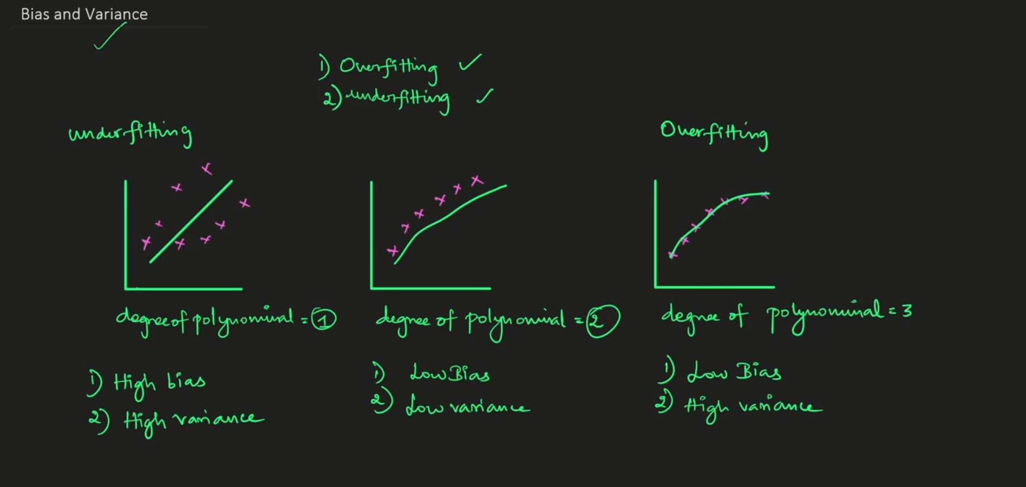

Slide 25
Regression model
Overfitting -> (degree of polynomial is 1) high bias, and high Variance, because of the vertical and horizontal distance is not so accurate it will give poor result in test data as well as training data
Underfitting -> (degree of polynomial is 3, line is more flexible) low bias, and high Variance, it will give good result in training data and poor performance in training data.
Generalized model -> low bias and low variance, degree of polynomial

Slide 26
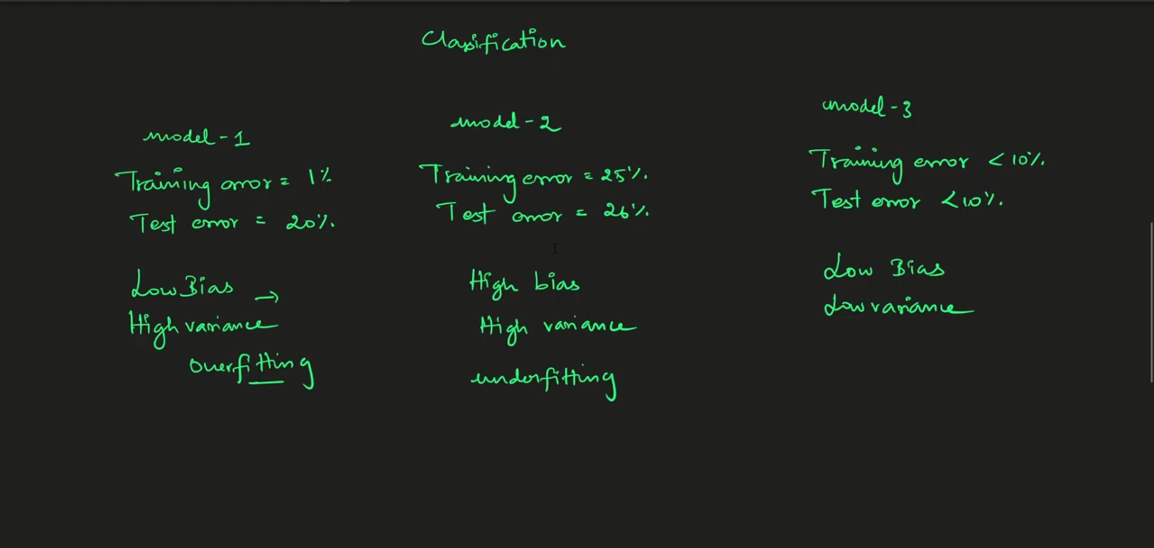

Slide 27
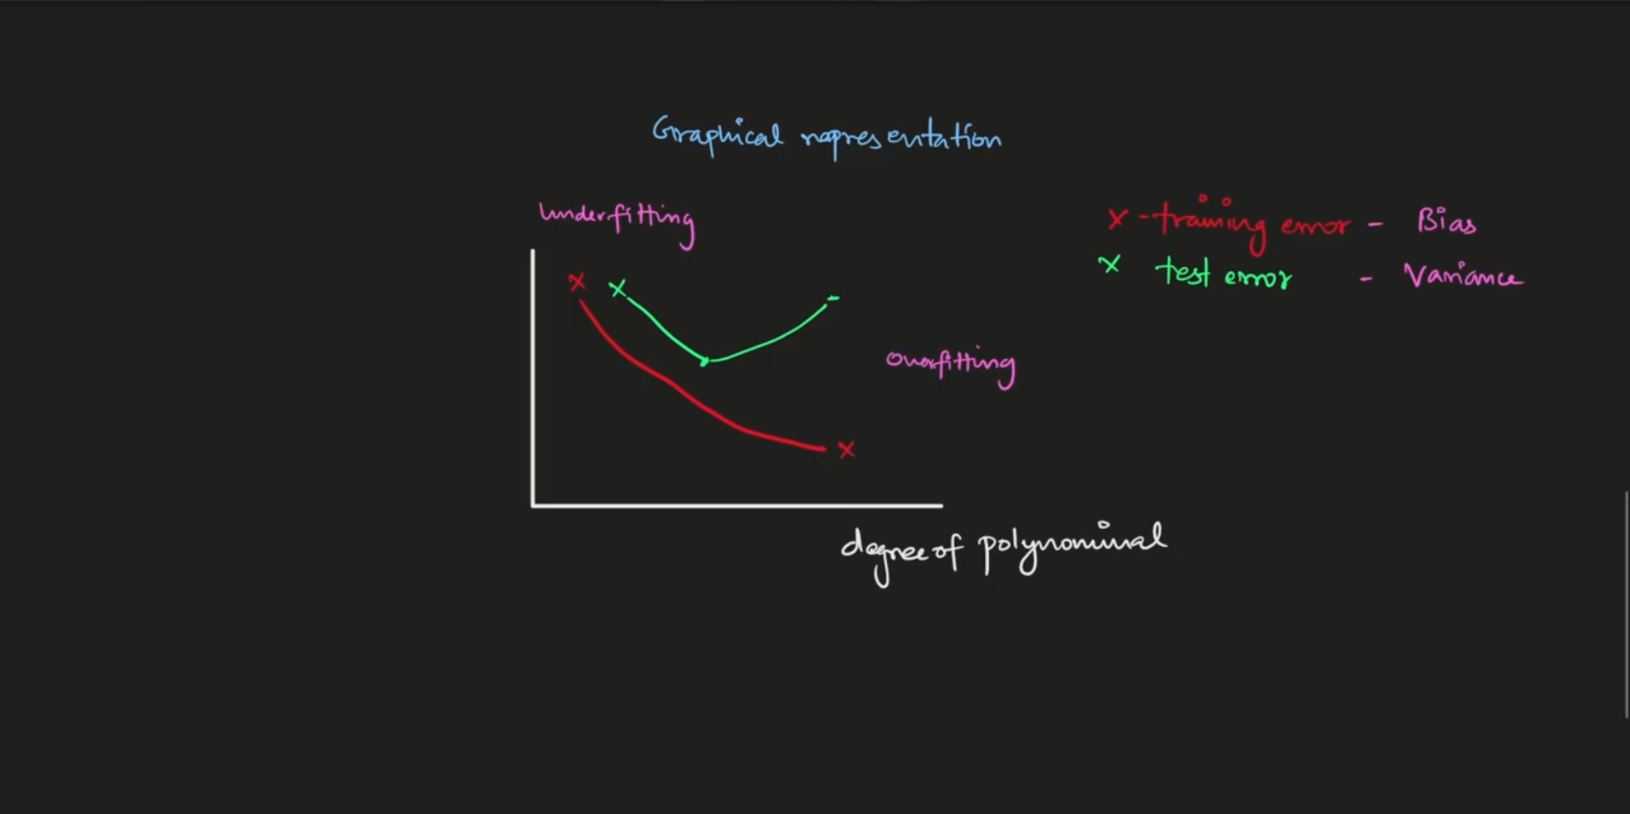

Slide 28
Reducing Variance through Regularization
Where the high variance will be -> when we overfit the data there high variance will be
In our Linear regression there will be some high variance, instead of going with linear regression we got some regularization techniques will be there
One of the regularization technique will be ridge and lasso regression(shrinkage penalty)

Slide 29
